Slide 1
Artificial Intelligence: Vision
Stages of analysis
Low level vision
Surfaces and distance
Object Matching

Slide 2
Introduction
Another “mundane” task involves being able to make sense of what we see.
We can handle images of objects
  differing in:
    size
    orientation
    color
    lighting
    expression (for faces etc)
  obscured by other objects
And recognize the objects in the scene, and what is happening in the scene.

Slide 3
Vision task
Ultimate task:
  from visual signal (digitized image) to representation of the scene adequate for carrying out actions on the objects on the scene.
  E.g., image of parts of device --> representation of location, orientation, shape, type etc of parts enabling robot to assemble device.
More limited task:
  recognize objects (from limited set) - is it a widget, wodget or wadget?

Slide 4
Stages of processing
Like NLP, we are mapping from an unstructured raw signal to a structured meaningful representation.
Like NLP we do it in stages:
  Digitization - raw data -> digitized image (e.g., 2d array of intensity/brightness)
  Low level processing - identify features like lines/edges from the raw image.
  Medium level - determine distances and orientation of surfaces.
  High level - Create useful high level representation (e.g., 3-d models, with objects and parts identified)

Slide 5
Low level Processing
Ignore digitization. First task then is to extract some primitive features from the image.
We might have a 512x512 image, where each image point (pixel) has a certain image intensity or brightness, represented by a number 0-255.
For color need three numbers per image point (blue, green, red), but start just considering b&w.
We start with a “grey-level” image. Image intensity sometimes called grey level.

Slide 6
Edge Detection
Consider the image below:
First task is to find the “edges” of the image. We obtain, from the array of grey levels, a “sketch” consisting of a number of lines.

Slide 7
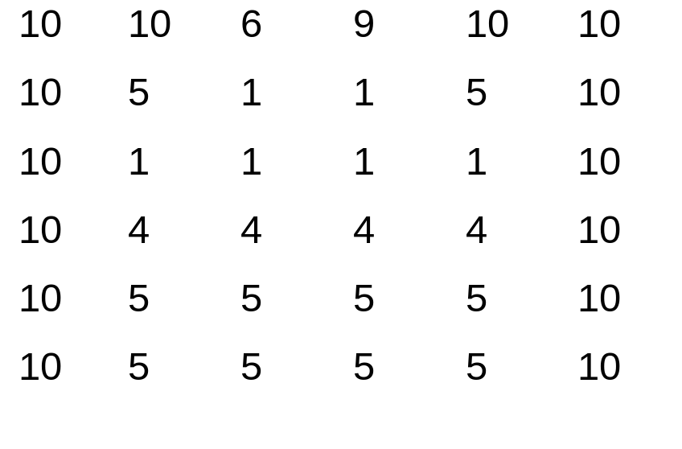
Simplifying..
Lets see what it might look like as an array of intensity values (ignoring door, window)
Edges occur where the intensity value changes significantly.
We find the difference between intensity values at neighboring points, and if large, mark poss. edge.

Slide 8
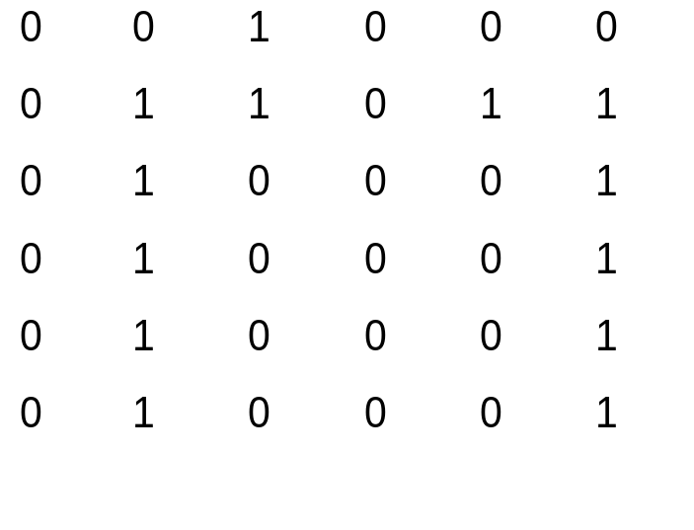
Applying difference operation
Just considering horizontal differences, and marking when the difference is greater than a threshold of 3, we get the following:
Have found vertical sides of house and bits of roof.
Similar operations let us find other edges.

Slide 9
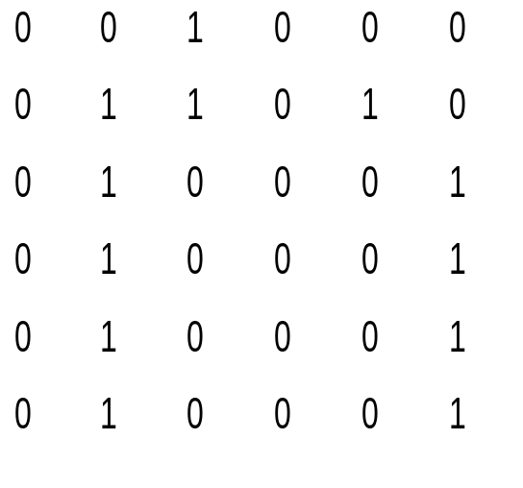
Line Fitting
We’ve now got a simplified image with points corresponding to edges in an image marked in.
Next task is to get from that to a set of lines.
This reduces the amount of data and gets closer to useful representation.

Slide 10
Simple Approach: Tracking
Find an edge point.
Look at all surrounding points to find connected edge points.
Keep going while the points you are finding form a straight line. When no more points in that direction, stop and make last one end point of line.

Slide 11
Problems..
What about:
  curved lines
  obscured lines (e.g., edge of an object, when parts of that edge are obscured by another object).
Solution is to try and find candidate likes such that the number of edge points falling on that line is maximized.
We consider all lines, and find those that seem to have lots of edge points on them.

Slide 12
Surfaces
We’ve looked first at low level vision:
  Find candidate edge points where intensity level changes quickly.
  Find lines (where many edge points fall on possible line).
Next stage is to find surfaces, and their distance from viewer and orientation. This gives us a 3-d model of object(s) in the scene.

Slide 13
Consider
Is this:
  Rectangle with right hand side near viewer OR 4 sided shape with RHS longer than LHS.
  A small surface near the viewer, or a large surface a long way away from the viewer?
What cues to we have to help us determine this?

Slide 14
Sources of depth info
Stereo vision: Two eyes give slightly different images, allowing distance estimates.
Motion: If the viewer is moving, again we get multiple images which give us a clue.
Shading and texture. Consider:

Slide 15
Stereo Vision
How do the different images from our two eyes enable us to guess at distances?
Try holding pencil close to your eyes - close one eye then another. Pencil will be in different locations. Now move it further away. The amount the pencil “moves” will be less.
The difference in direction of an object, from one eye and from the other, depends on the distance away.
eyes

Slide 16
Stereo Vision
1. Find corresponding image features in two images.
2. Work out from that the angle that the feature would be from the camera (for each camera).
3. Do some geometry to get the distance.
Image from left
eye/camera
Image from right eye/camera

Slide 17
Stereo Vision
The math ends up quite easy.
For those who can recollect school trigonometry ..
Z = b sin α sin θ/ sin(180-θ-α)
  z is distance we are looking for
  b = distance between eyes
  theta is angle from one eye to object
  alpha is angle form other eye to object.
But tricky bit is the feature matching - how do we tell that an image point from one camera corresponds to a particular point from other.

Slide 18
Depth from Motion
Humans also use motion as an important cue for depth/orientation.
Try holding pencil near you, and moving head while keeping pencil still. Relative positions of pencil and background will change.
Diagram/Math similar to stereo vision.. (“eyes” now correspond to camera location at two time points).
Techniques however are different.

Slide 19
Texture and Shading
Texture, or regular repeated patterns helps in determining orientation (see slide 4).
We assume that the patterning is regular and conventional.
Shading also helps, especially if we know the light source.
Impression
of curving?

Slide 20
Object Recognition
We now have the tools to extract from an image a set of surface features, with given distances and orientation.
  E.g., feature 1 is a 20cmx40cm rectangular surface 2m away, sloping away from the viewer at angle 40º.
Next step is to:
  Put these together into a 3-d model.
  Recognize that it is a widget..

Slide 21
Object Models
We need to have a way of describing shapes of objects of interest (e.g., widgets), and also describing shapes in the scene.
Need 3-d models, so we can recognize objects from different viewing angles.
Base these on “volumetric primitives” (ie, 3d shapes) (e.g., cube, cylinder).
Now our first stage is to get from our surfaces, to possible shapes.
  Reasonably easy, if surfaces are right and no obscuring objects.

Slide 22
Object Models
Image of a house might end up with model:
Pyramid
+
Cube

Slide 23
Matching..
Now if we have stored the fact that
  house =pyramid on top of cube
We should be able to recognize the image as a house whatever orientation we view the house from.
So we match candidate object models to model of object(s) in scene, and find the closest match.

Slide 24
Summary
Vision - from grey level image to recognized object and model of scene.
Start with low level vision:
  Find candidate edge points where intensity level changes quickly.
  Find lines (where many edge points fall on possible line).
Then find surfaces, distances, match to 3d primitives and object models.

